Slide 1
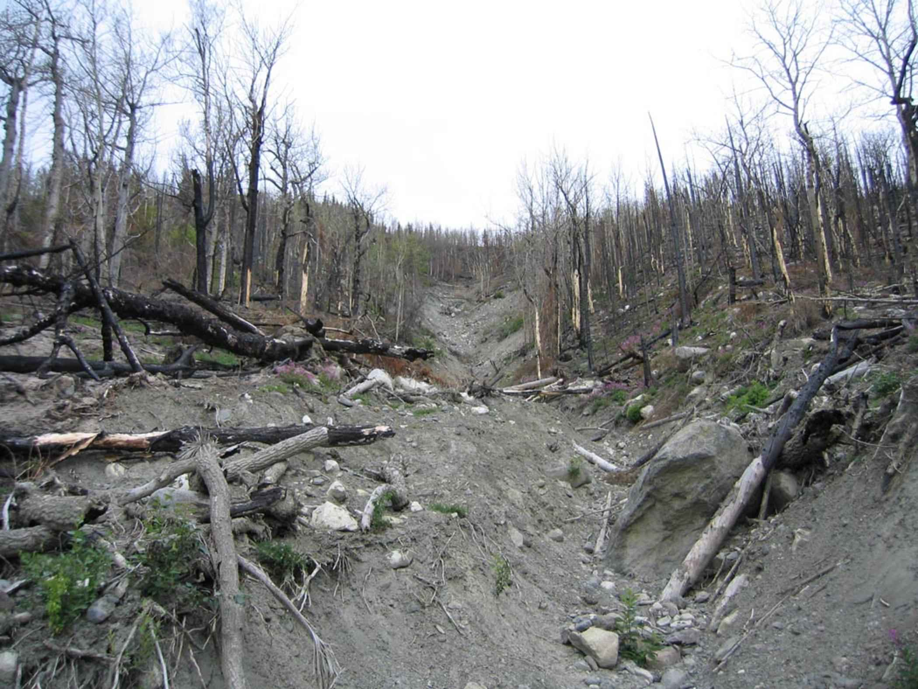

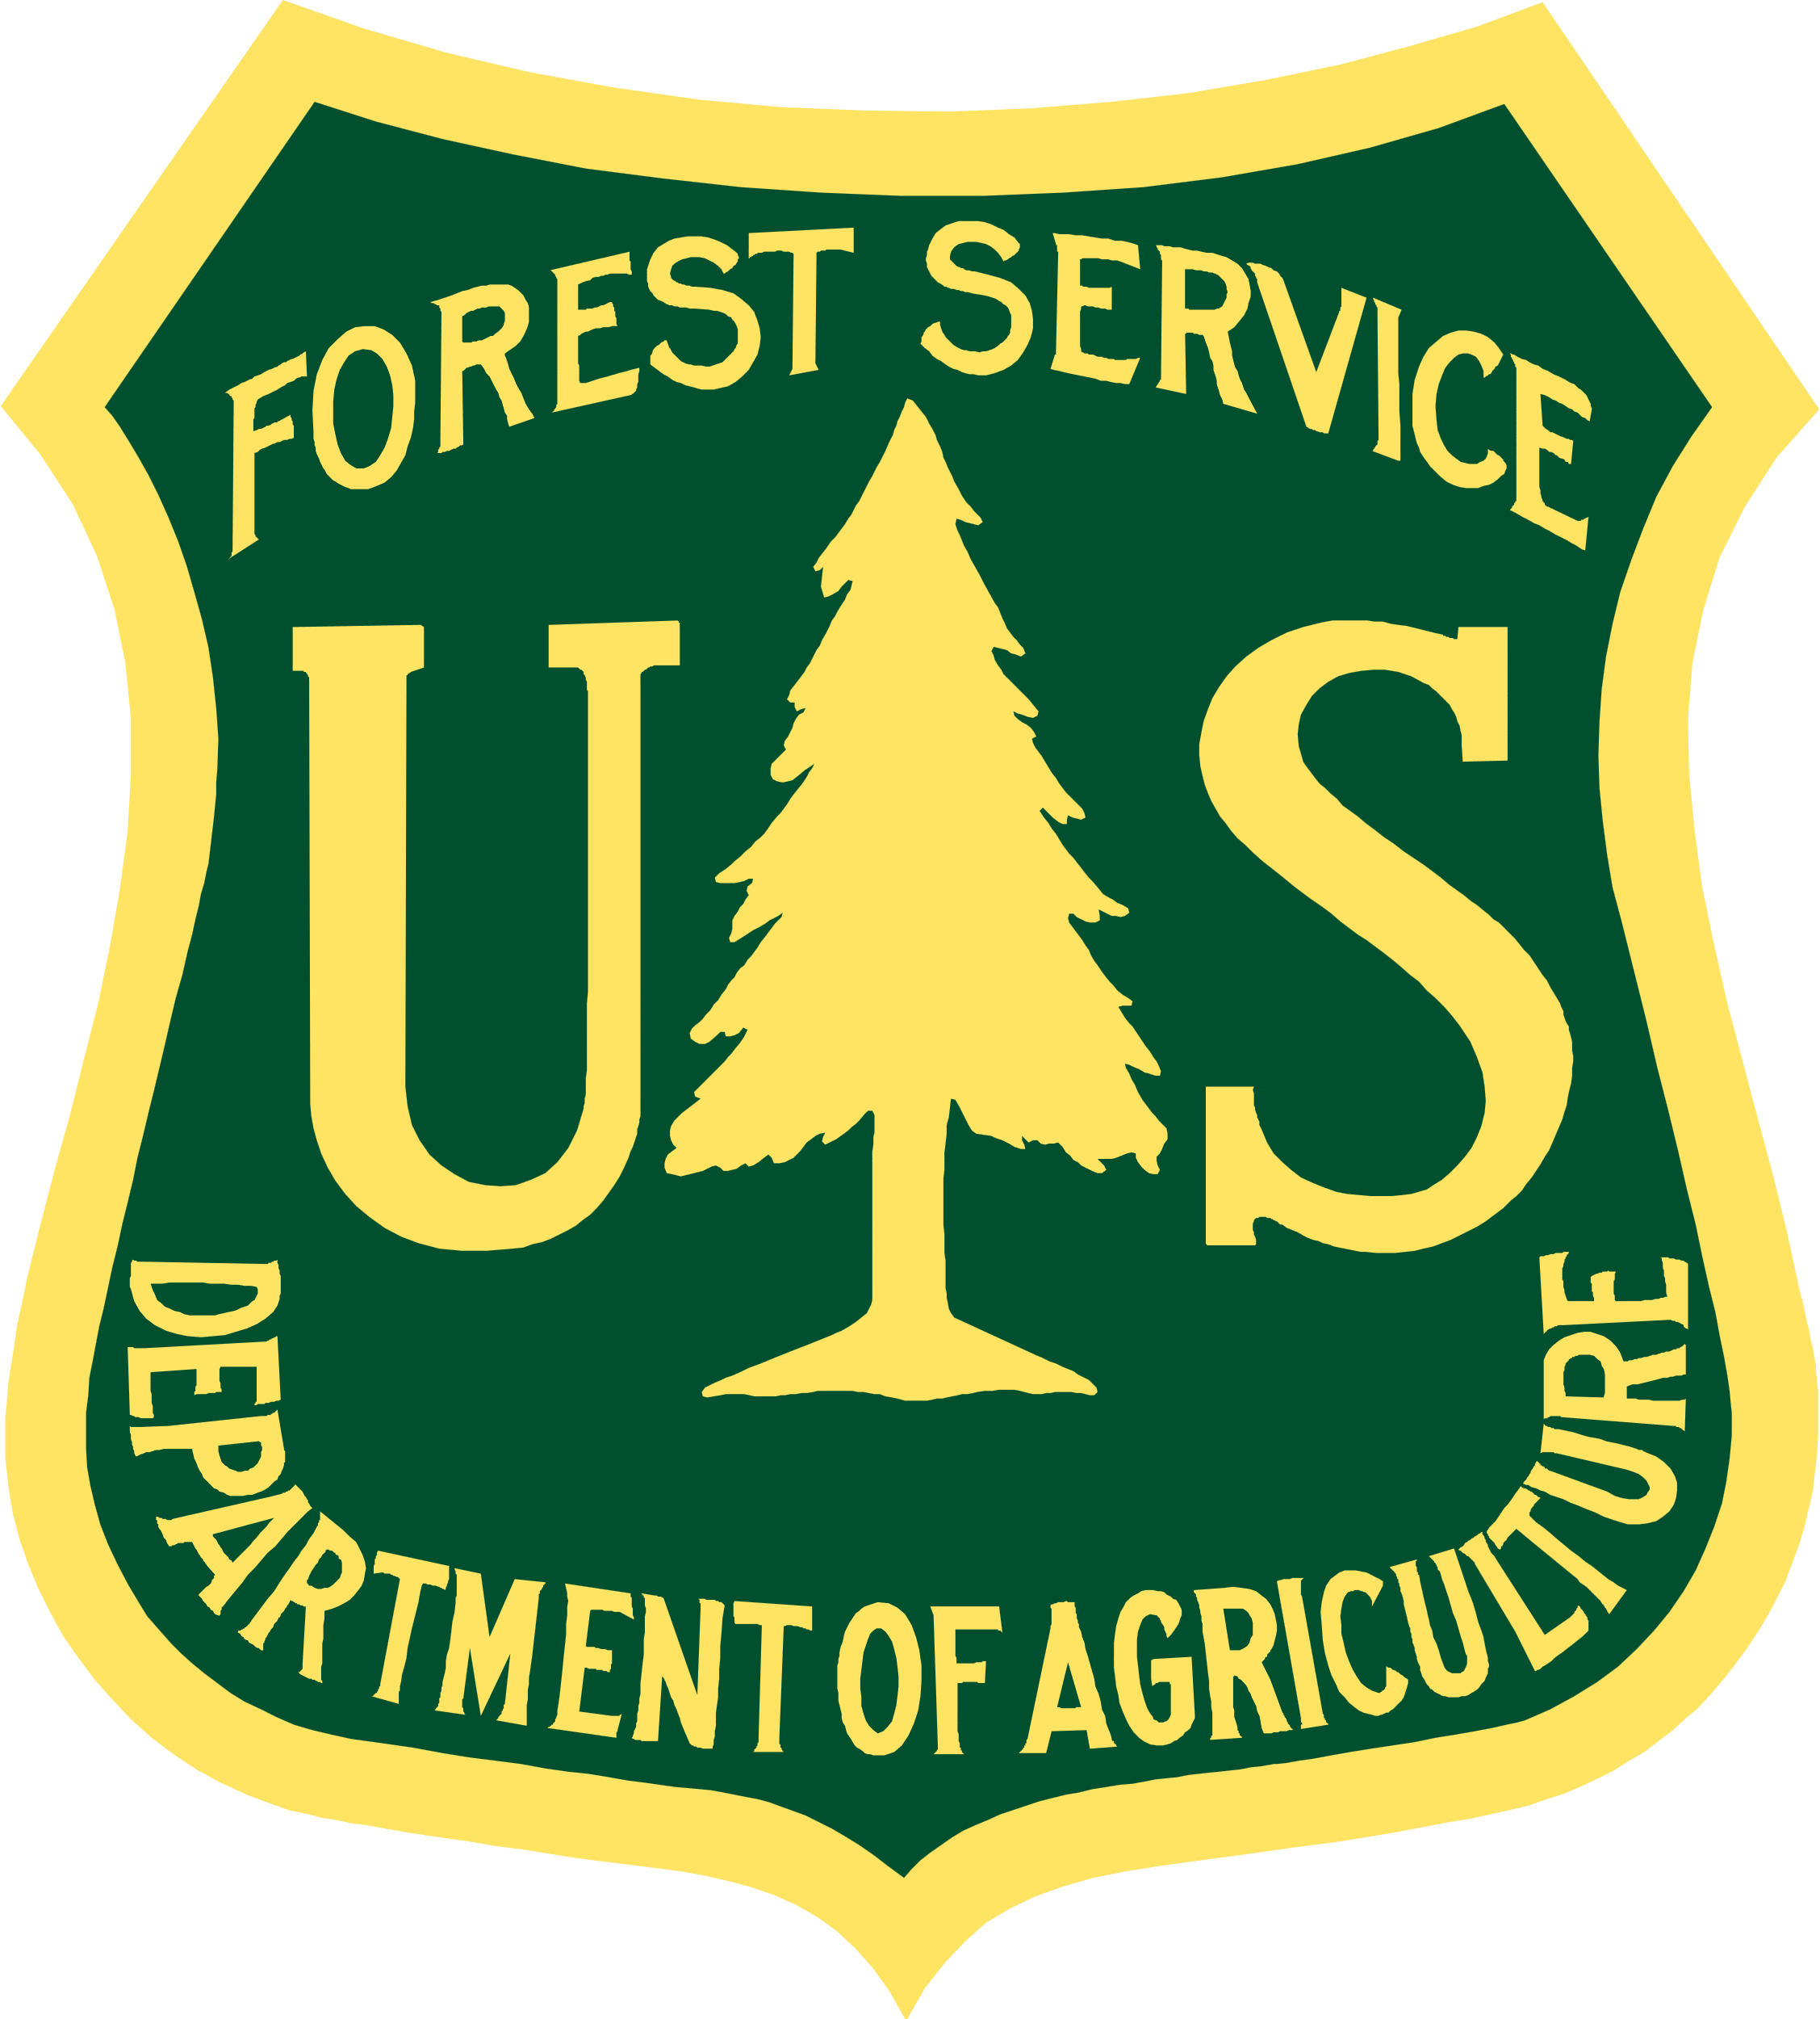

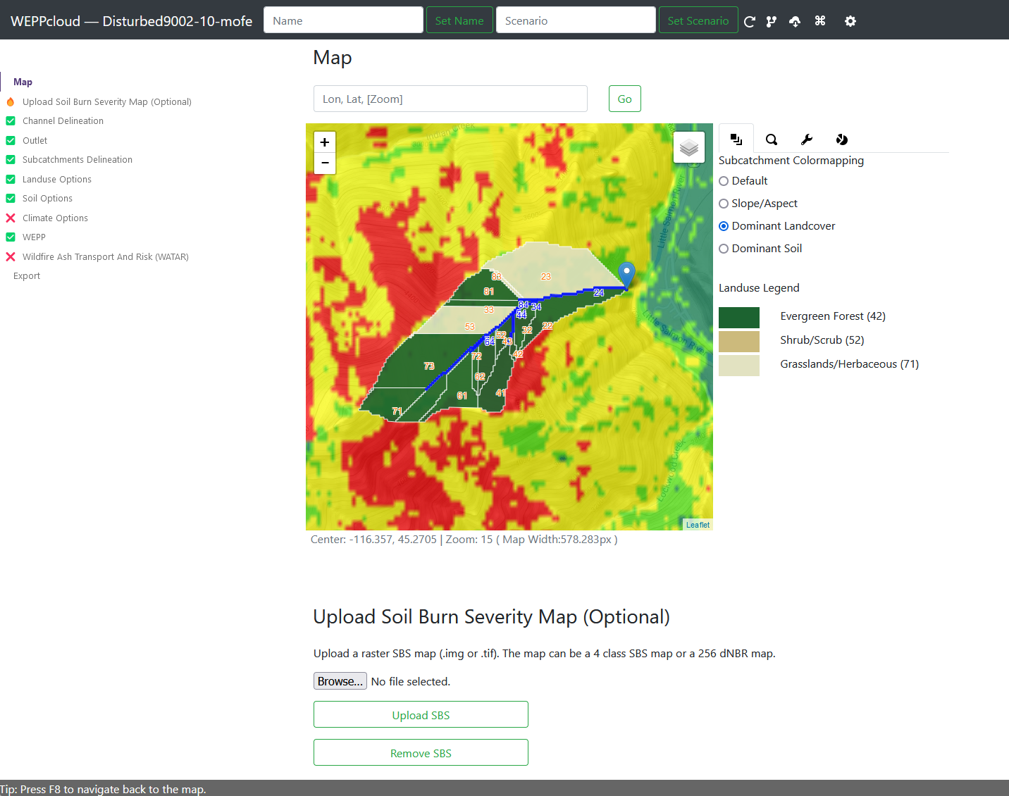
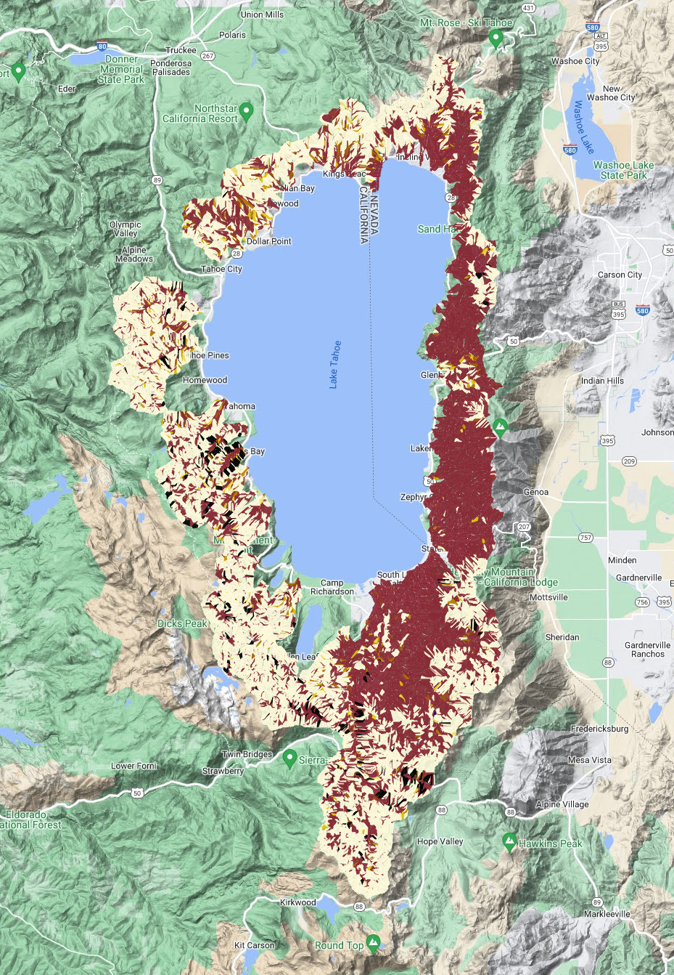

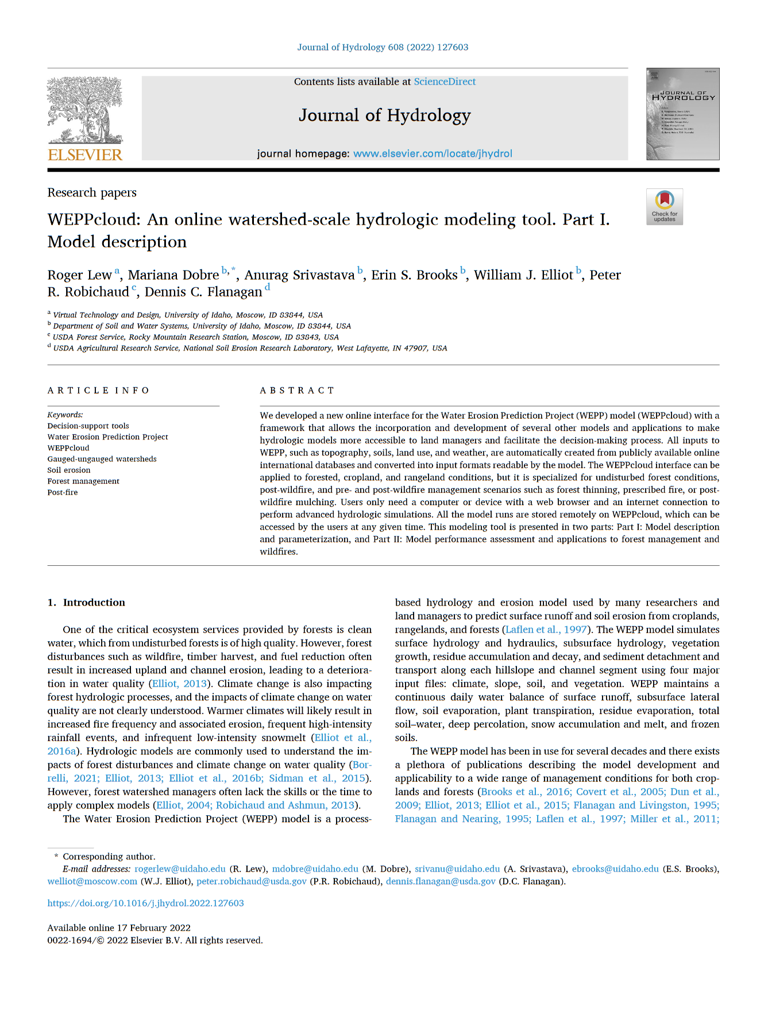
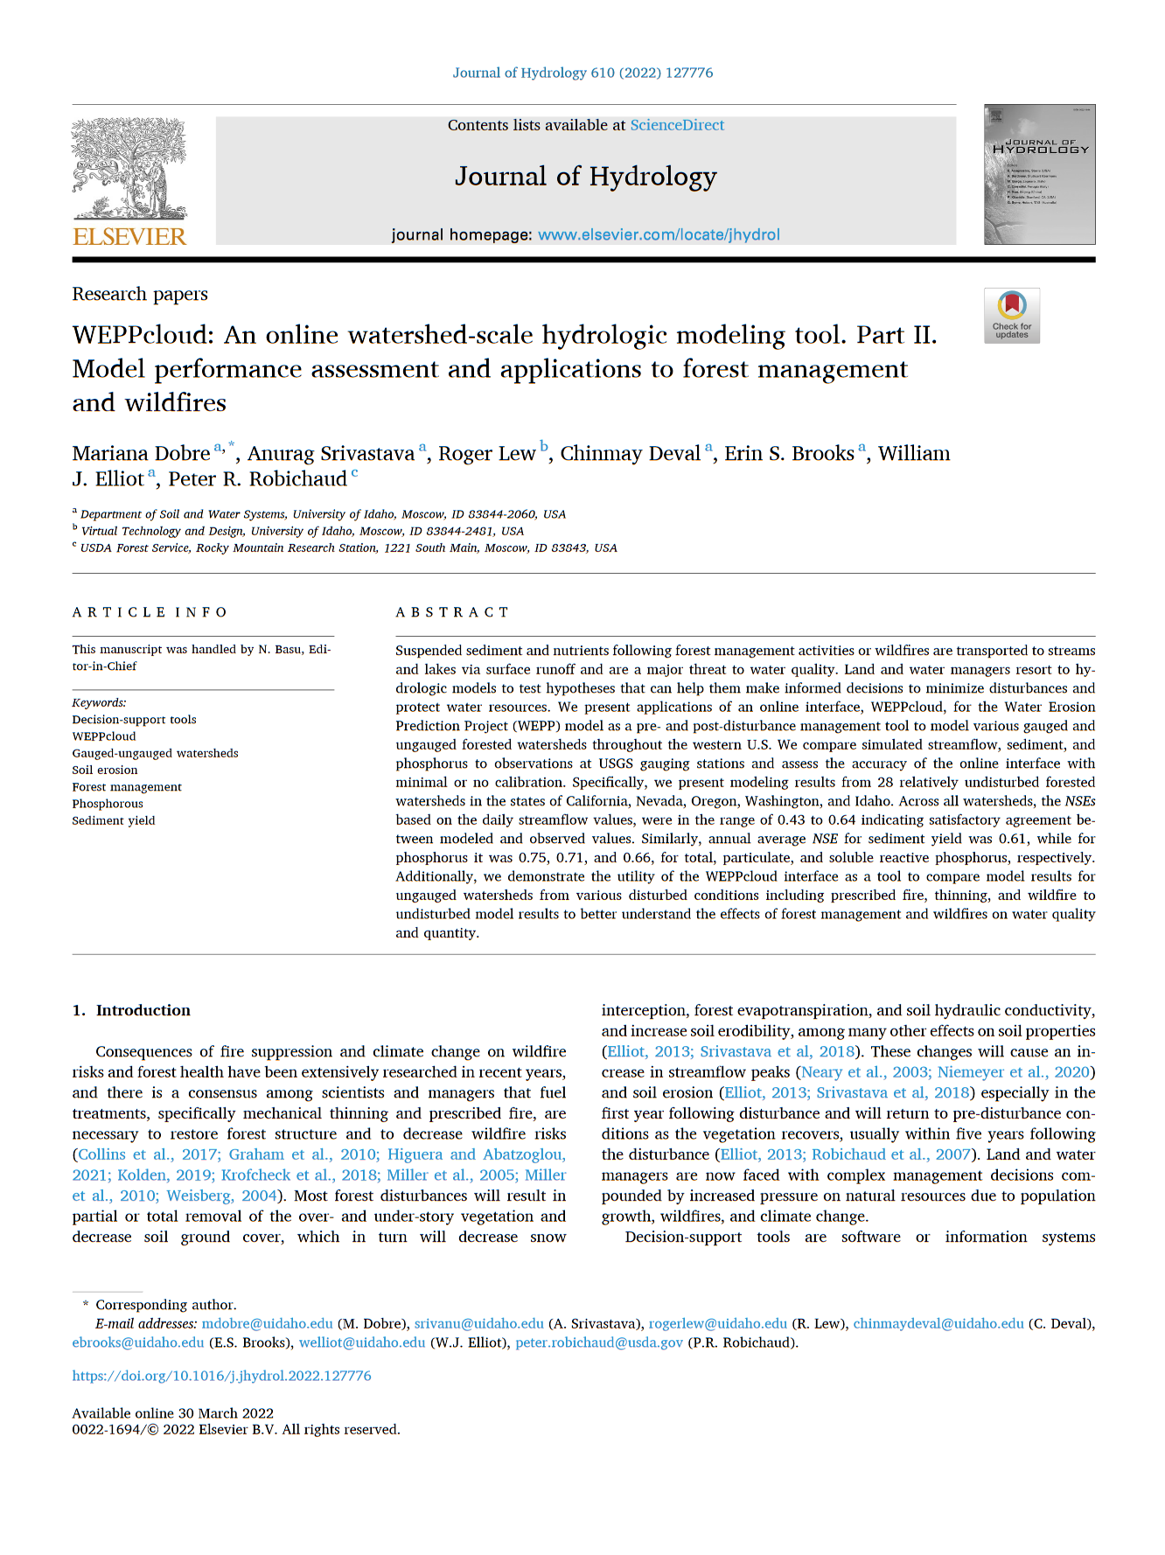
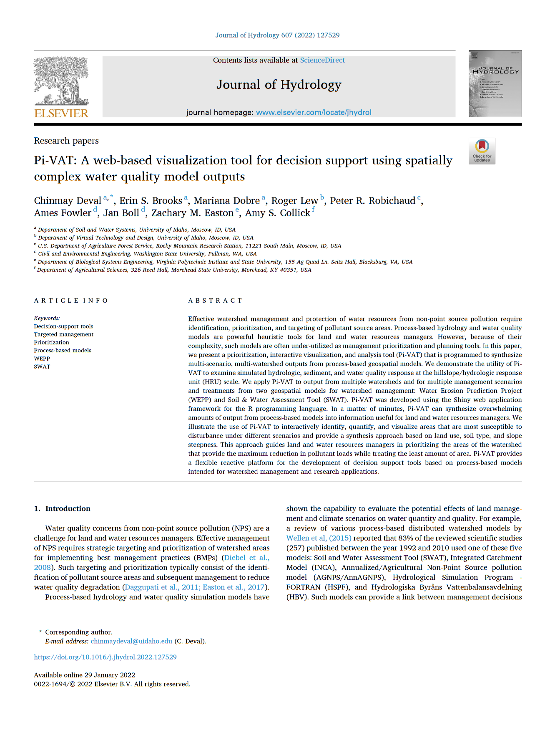
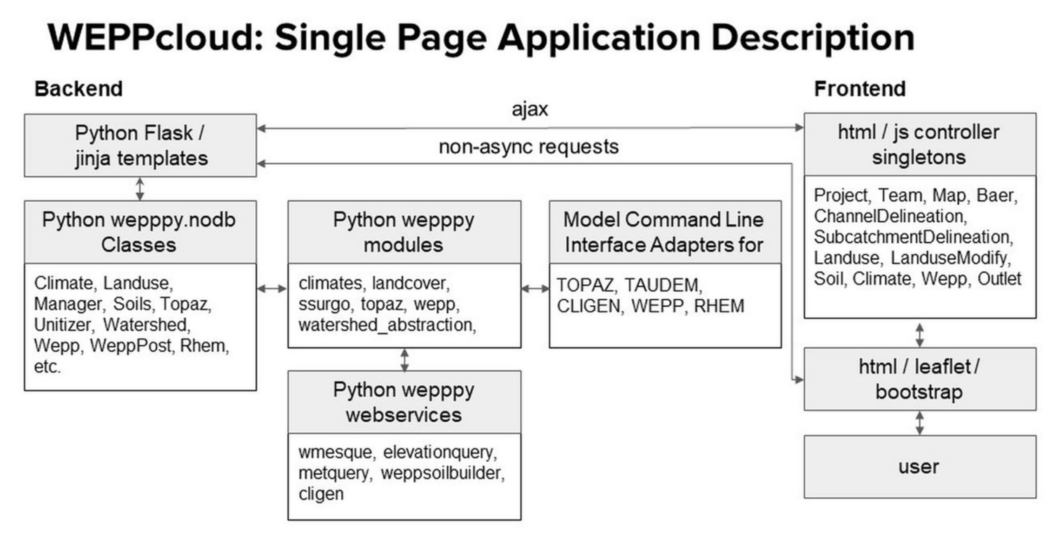



WEPP.cloud Online Hydrological Modeling and Decision Support for Wildfire Management
This Poster
Dr. Roger Lew Associate Research Professor Virtual Technology and Design, CAA, UI
Affiliate Faculty Dept. of Psychology and Comm. Studies, CLASS, UI
Dr. Erin S. Brooks Professor, Agricultural Engineer Dept. of Soil and Water Systems, CALS , UI
Dr. Mariana Dobre Research Scientist Dept. of Soil and Water Systems, CALS , UI
Dr. Peter R. Robichaud Research Engineer
Rocky Mountain Research Station USDA Forest Service
Dr. Anurag Srivastava Research Scholar Dept. of Soil and Water Systems, CALS , UI
Introduction
Online hydrology and soil erosion modeling for US, Europe, and Australia
Automates data acquisition and processing of geospatial datasets
Scenario based modeling for pre- post- fire and historical, stochastic, and future climates
Visualizations and reports for decision support
Post-fire ash transport modeling
Usage and Notable Users
In 2022: 86k projects and 6m hillslopes ran
USGS Burned Area Emergency Response
Lake Tahoe
Portland Municipal
Seattle Public Utility
Notable Datasources
USGS National Elevation Dataset
USGS Landcover 2001-2019
USGS SSURGO Soils
Climates: GRIDmet, PRISM, DAYMET
NOAA Rainfall Intensity
RAP for historical tree, shrub, and ground cover
Technology and Cyberinfrastructure
Open-source Python based modeling framework (github.com/rogerlew/wepppy)
Hosted by University of Idaho Research Computing + Data Services (RCDS)
Watershed Erosion Prediction Program (WEPP) Hydrological Model
is a process-based erosion and hydrology model
Several decades of use and application to agriculture and forested regions
WEPPcloud is unique in its ability to:
Automate the acquisition and processing of datasets
Conduct multiple-watershed scenario-based modeling
Provide user model for data sharing and data privacy
Develop cutting edge modeling advancements while maintaining (e.g. better parameterization, multiple overland flow elements, etc.)
Advanced Features
Can conduct batch runs of multiple watersheds with factorial conditions (Lake Tahoe had ~60 watersheds with current, historic, and future climates, and current, predicted, low, moderate, and high severity fire)
Open data model. Users can download and calibrate projects offline, use datasets for other purposes
Runs other models in addition to WEPP such as RHEM (rangelands), WATAR (ash transport modeling)
Funding, Acknowledgments, Collaborators
NSF Idaho EPSCoR Program and by the National Science Foundation under award number IIA-1301792.
This work is supported by AFRI program [grant no. 2016-67020-25320/project accession no. 1009827] from the USDA National Institute of Food and Agriculture.
The Wildfire Ash Transport And Risk estimation tool (WATAR) was made possible with collaboration from Swansea University and the US-FS, and funding provided by UK NERC Grant NE/R011125/1 and European Commission (H2020 FirEUrisk project no. 101003890)
NASA ROSES / NASA Vegetation
Continued funding from US-Forest Service
Hosting through UI RCDS
Notable Collaborators: Bill Elliott (USFS), Sarah Lewis (USFS), Bob Brown (USFS), Nancy Gibson (USFS), Dennis Flanagan (USDA), Jim Frankenberger (USDA), Jan Boll (WSU), Jennifer Adams (WSU), Chinmay Deval (UI), Jonay Neristome (Swansea), Stefan Doerr (Swansea), Helen Dow (USGS), Jonay Neristome (Swansea), Stefan Doerr (Swansea)
Notable Publications
Online WEPPcloud Interface
Soil Deposition and Loss Map

